Slide 1

AMAZON RDS (RELATIONAL DATABASE SERVICE
PRESENTED BY
L NARENDRA

Slide 2
AGENDA
What is aws rds
Aws rds services
Choice of data base engines
RDS READ AND WRITE
Backups and disaster recovery
Push button scaling
INCLUDES VALUABLE RDS FUNCTIONALLY
VERSION UPDATES
Cost of Amazon RDS
How to Set Up Amazon RDS?

Slide 3
What is aws rds
Amazon Relational Database Service (Amazon RDS) is a collection of managed services that makes it simple to set up, operate, and scale databases in the cloud.

Slide 4
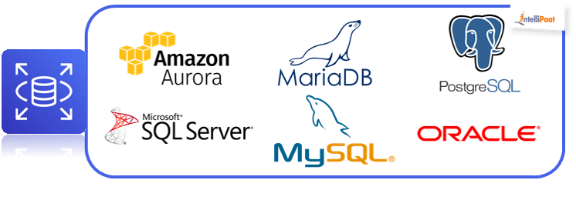
Aws rds services

Slide 5
Choice of database engines
MANAGED SERVICE
EASY TO SCALE AND OPERATE
HIGH PERFORMENCE
HIGH AVAILABILITY

Slide 6
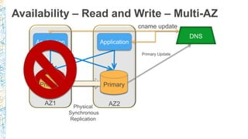
RDS READ AND WRITE
Amazon RDS Multi-AZ deployments provide enhanced availability and durability for your Amazon RDS database (DB) instances, making them a natural fit for production database workloads. With two different deployment options, you can customize your workloads for the availability they need.

Slide 7
Backups and disaster recovery
DB SNAPSHOTS
- user-driven snapshots of database
- kept until explicity deleted
AUTOMATED BACKUPS
- nightly system snapshots + transaction backups
- enables point- in –time restore to any point in relation period up to the
the last 5 minutes
CROSS REGION COPY
- change region
- disaster recovery

Slide 8
Push button scaling
SCALE NODES VERTICALLY UP OR DOWN
- 14 current generation DB instance classes
- db t2 micro (AWS free usage tier)
- db .r3 8xlarge (32 virtual cross 244GB)
ONLINE STORAGE SCALING 5GB TO 3TB
- magnetic & general purpose SSD
- SSD up to 30000
SCALE OUT NODES HORIZONTALLY
- shard based on data or workload characteristics
- fast and easy database creation

Slide 9
INCLUDES VALUABLE RDS FUNCTIONALLY
Fast deployment
Backups and point-in-time recovery
Snapshots and restore
Compute and storage scaling
Multy-AZ
Provisioned IOPs

Slide 10
VERSION UPDATES
RDS NOW SUPPORTS
9.3.6- fix for RDS Bug – reset all
9.3.9 (Default)
9.4.1 and 9.4.4 (defualt)
- JSON
- GIN index improvements

Slide 11
Cost of Amazon RDS
When using Amazon RDS, pay only for only the usage without any minimum and setup charges. Billing is based on the following criteria
Instance class − Pricing is based on the class of the DB instance consumed.
Running time − Price is calculated by the instance-hour, which is equivalent to a single instance running per hour.
Storage − Bill is calculated as per the storage capacity plan chosen in terms of per GB.
I/O requests per month − Billing structure also includes total number of storage I/O requests made in a billing cycle.
Backup storage − There is no additional charges for backup storage up to 100% of database. This service is free only for active DB instances.

Slide 12
How to Set Up Amazon RDS?
Step 1 − Login to AWS management console. Use the following link to open Amazon RDS console − https://console.aws.amazon.com/rds/
Step 2 − Select the region where the DB instance is to be created, at the top right corner of the Amazon RDS console.
Step 3 − Select Instances in the navigation pane, then click Launch DB Instance button.
Step 4 − The Launch DB Instance Wizard opens. Select the type of instance as required to launch and click the Select button.

Slide 13
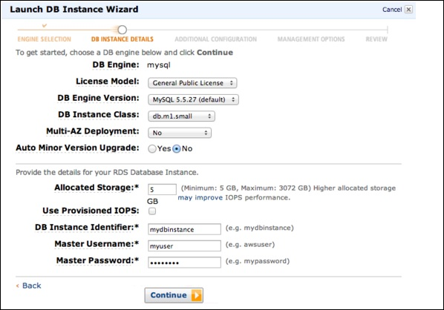
Step 5 − On the Specify DB Details page, provide the required details and click the Continue button

Slide 14
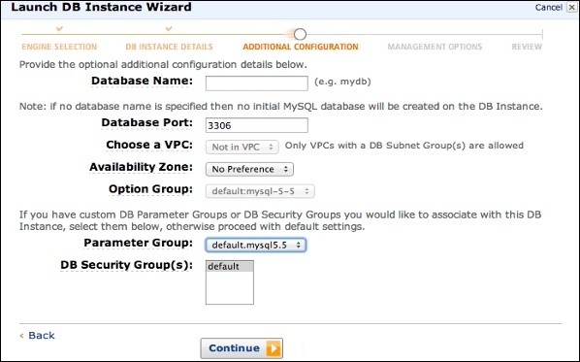
Step 6 − On the Additional configuration page, provide the additional information required to launch the MySQL DB instance and click the Continue button.

Slide 15
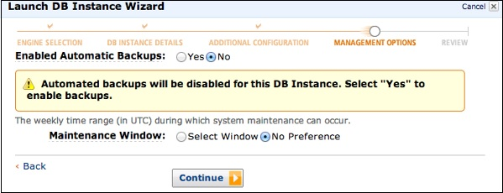
Step 7 − On Management options page, make the choices and click the Continue button.

Slide 16
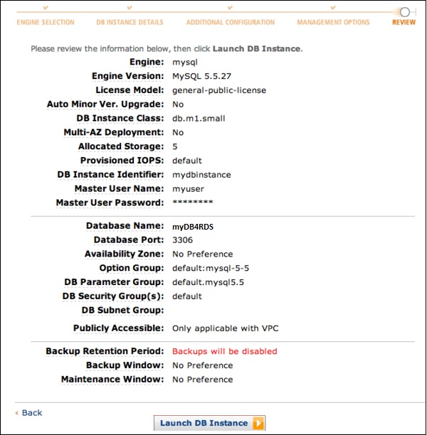
Step 8 − On the Review page, verify the details and click the Launch DB Instance button.

Slide 17
THANK YOU

